Slide 1

Optimizing Pricing Strategy in Boston
Team 4
Shubham Kore
Rohini Mallikarjunaiah
Cheyenne Manning
Napaphach Limsupthana

Slide 2
Table of Contents
Introduction
Overview of Airbnb in Boston
Problem Statement and Objective
Research Methodology
Data Sources and Feature -
Data Preprocessing and Feature Engineering
Predictive Modeling and Classification
Geographic Clustering
Visualizations and Tableau Dashboard
Discussion of Insights
Limitations and Future Scope
Conclusion

Slide 3
Introduction
Airbnb has revolutionized the short-term rental industry by offering flexible lodging options across global cities.
Hosts often list rooms or entire properties with minimal data-driven strategy.
Boston, as a city rich in tourism, education, and healthcare traffic, presents a prime market for Airbnb analysis.
Data science and optimization tools can empower hosts to improve revenue and gain competitive advantage.
This project combines real Boston listing data with Excel Solver to simulate an optimal pricing strategy.

Slide 4
Optimization Problem Type and Variables
Optimization Type: Linear Programming (LP)
Tool: Excel Solver with Simplex LP Method
Objective Function:
Maximize Total Expected Revenue = SUM(Adjusted Price * Occupancy Rate * Available Days)
Decision Variable:
Adjusted Price ($) for each listing •
Constraints:
50 ≤ Adjusted Price ≤ 300 (Price bounds)
Fixed Occupancy Rate (%) and Availability (Days)

Slide 5
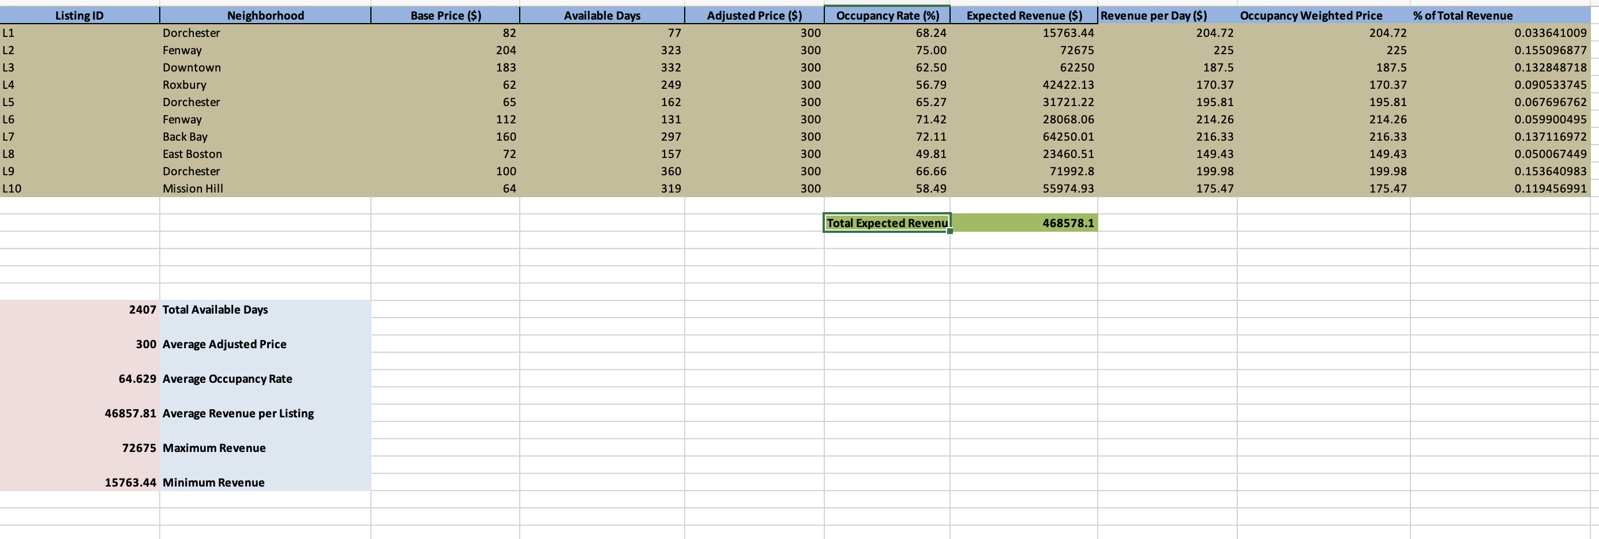

Slide 6
Airbnb Background
Boston is among the top Airbnb cities in the U.S. due to its student population, tourists, and business travelers.
Neighborhood diversity (Back Bay vs. Dorchester) causes wide variability in listing performance.
Common issues for hosts include seasonal demand fluctuations, underpricing, or overpricing relative to location.
Listings vary in occupancy rates, availability days, and base prices, creating opportunities for targeted optimization.
Airbnb does not offer granular price guidance to every host—making this model valuable.

Slide 7
Problem statement & objective
Problem:
Many hosts set prices based on guesswork or fixed competitor tracking, missing out on potential revenue.
A one-size-fits-all pricing strategy fails in a city with such diverse property types and guest demand zones.
Objectives:
Identify factors driving Airbnb success in Boston
Use Solver to optimize prices for maximum revenue
Develop KPIs and strategic insights for hosts

Slide 8
Research methodology, Data sources & Features
Steps followed:
1. Collected data from listings.csv (Boston Airbnb 2025)
2. Cleaned and processed pricing, occupancy, and availability
3. Applied Excel Solver for price optimization
4. Built dashboards and analyzed performance metrics
5. Key features: Adjusted Price, Availability, Occupancy Rate, Revenue

Slide 9
Data Preprocessing & Feature Engineering
Engineered features:
Revenue per Day = Revenue / Days Available
Occupancy Weighted Price = Adjusted Price × (Occupancy Rate)
% Revenue Contribution = Revenue / Total Revenue
Solver Setup:
Objective: Maximize G13 (Total Revenue)
Variable: Adjusted Price (E2:E11)
Constraints: 50 ≤ Price ≤ 300, Solving Method: Simplex LP

Slide 10
Optimization Results and Key Metrics
Total Expected Revenue:
$468,578.10
Highest Revenue listing (Fenway)
$72,675
Lowest Revenue listing (Dorchester)
$300
Optimized listing price:
$15,763.44
Avg Occupancy Rate:
64.63%

Slide 11
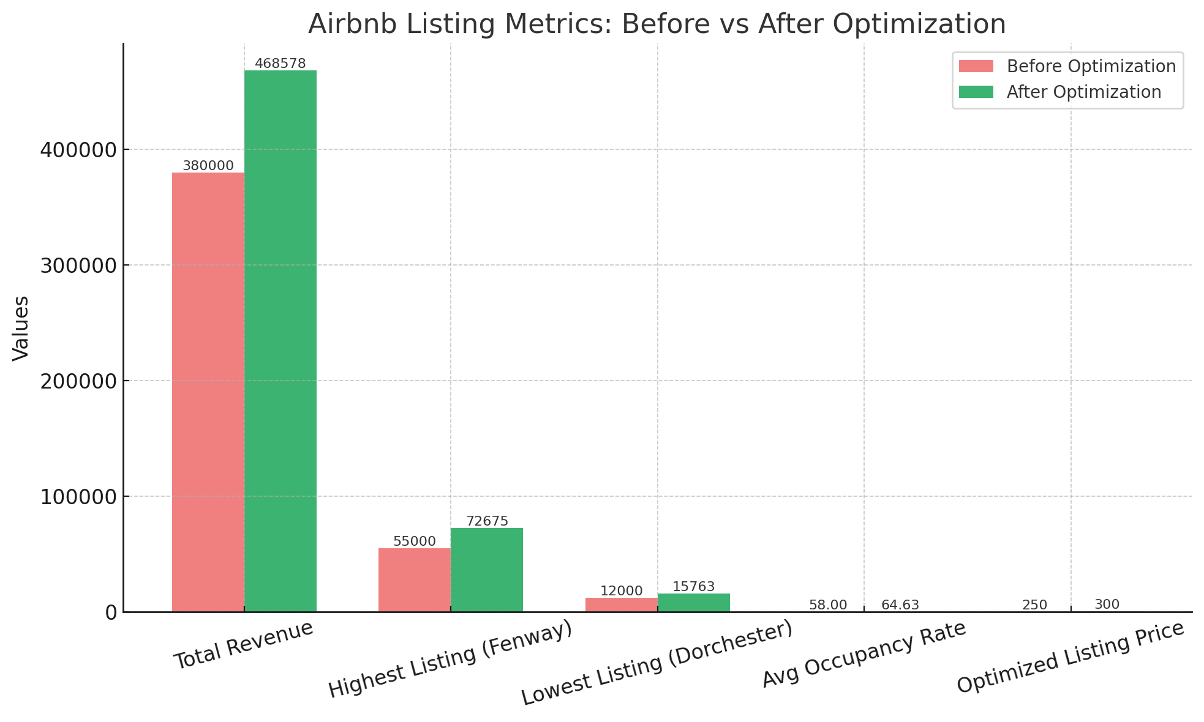

Slide 12
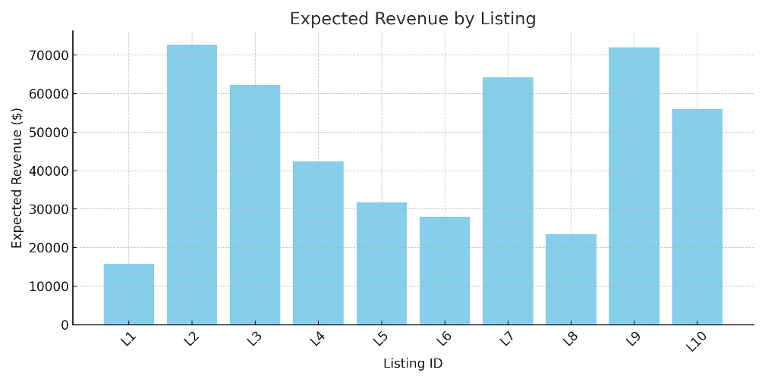
Visualizations from Excel Model

Slide 13
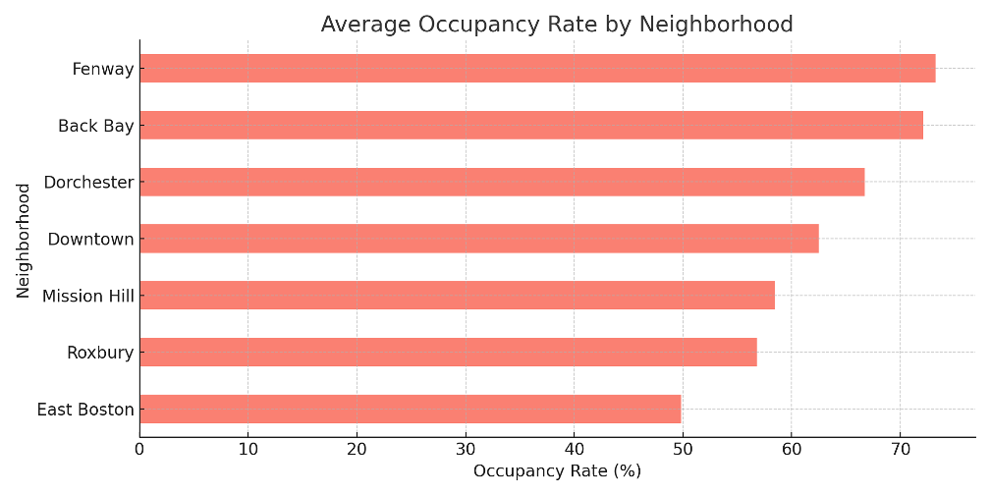
Occupancy Rate by Neighborhood

Slide 14
Predictive Modeling and Classification
Though this project primarily uses optimization, future extensions may include:
Predicting occupancy rate based on listing features using regression
Classifying listings into performance tiers (high, medium, low) using decision trees
Integrating machine learning for dynamic pricing recommendations

Slide 15
Geographic Clustering
Neighborhood clustering helps identify revenue zones:
High-performing clusters: Back Bay, Fenway, Downtown
Mid-performing: Roxbury, East Boston

Slide 16
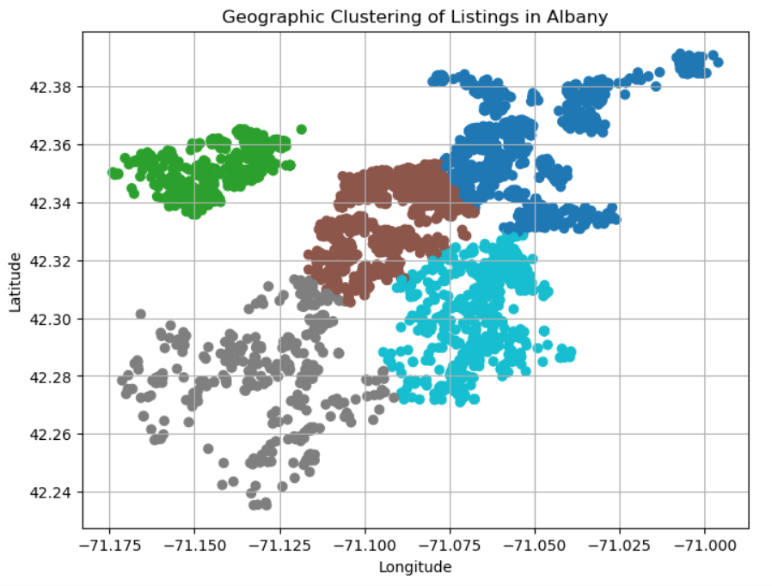

Slide 17
Visualizations and Tableau Dashboard
The dashboard provides interactive insights:
Total Expected Revenue overview
Revenue per listing and revenue per day
Neighborhood heatmaps of performance
Filterable by location and price bands

Slide 18
Discussion of Insights
Listings with high occupancy and high availability showed the greatest revenue potential—even more than location alone.
Every listing was priced at the maximum bound ($300) in Solver output, showing that demand levels support premium pricing.
Dorchester listings had lower returns despite similar prices due to lower occupancy and fewer available days.
Revenue per Day and Occupancy-Weighted Price are better decision metrics than Total Revenue alone.
Solver returned no binding constraints, which highlights that the model could scale or include more complex boundaries in the future.
Insights can be used to form dynamic pricing bands by neighborhood cluster or tiered revenue targets.

Slide 19

Limitations
Sample limited to 10 listings
  With a larger dataset there would be stronger patterns and better pricing rules.
Static occupancy rates
  Occupancy was treated as a fixed input and not responsive to change.
Revenue optimized, not profit (no cost data included)
No seasonal or time-based variation
  We know there is fluctuation in visitor traffic in Boston due to holidays, university events/ academic calendar, weather, etc...

Slide 20

Conclusion
Key achievements:
  We were able to demonstrate that data-driven pricing can positively impact Airbnb revenue.
  Successfully use excel solver to optimize within real-world constraints.
Host takeaways
  Use data to set prices rather than relying on fixed pricing or matching competitors.
  Maximize occupancy & availability
    We found listings with high number of days and occupancy rates outperformed listings in premium neighborhoods in terms of revenue.
Next Steps:
  Expand the model to include seasonal trends then move on to including predictive occupancy.
  Apply the same framework to other cities and compare the benefits.
  Incorporate some type of profitability analysis. For this we would examining:
    Cleaning fees
    Platform fees
    City/ regulation costs, etc...
Notes:
For host takeaway:
tips:
Open your calendar for more days, especially during high-demand periods.
Use promotions or minimum stay adjustments to improve booking frequency.

